Slide 1
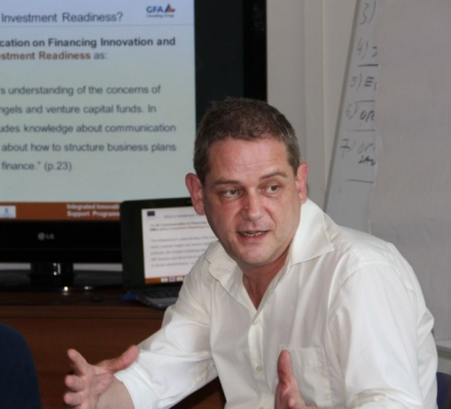
COSME Strategic Plan 2020 and Action Plan 2015-2017
Stephen Batstone
Senior Expert

Slide 2
Purpose
COSME Programme Implementation in Moldova

Slide 3
COSME Concept
COSME concept document:
Proposed implementation approach
Organisational structure
Key actions
Action Plan:
Series of activities for the period 2015-2017

Slide 4
Sequence of required steps
Establish Enterprise Europe Network (EEN) (by Q.1, 2015)
Set-up management structures for implementing COSME (Q.1-2, 2015)
Annual Implementation
Monitoring and evaluation

Slide 5
Specific Objectives- institutional participation
OS1.1: Maximise the financial return on investment of participation in COSME
OS1.2: Strengthen institutional capacities of SME support infrastructure to deliver effective business support
OS1.3: Improve the range, quality and complementarity of high quality SME support measures available to all SMEs

Slide 6
Specific Objectives – results from participation
OS2.1: Improving access to markets, especially within the EU
OS2.2: Improving policy framework conditions relevant to SME development
OS2.3: Promoting entrepreneurship and entrepreneurial culture

Slide 7
Key Strategic Targets related to SO2.1: Improving access to markets
The most important Action related to this specific goal will be the successful development of the Enterprise Europe Network within Moldova
The EEN will develop a core institutional structure that can coordinate the development of Actions related to this specific goal

Slide 8
OS2.2: Improving policy framework conditions relevant to SME development
Identify at least 4 relevant Actions per year, from the Annual Workplan
Submit at least 2 proposals per year in response to Calls for Proposals
Successfully implement at least 2 COSME Actions on improving policy framework conditions in the period to 2020

Slide 9
OS2.3: Promoting entrepreneurship
Ensure Moldovan participation in Erasmus for Young Entrepreneurs
Further strengthen the provision of entrepreneurship education within vocational education and training, and within higher education
Increase the number of SME Week activities by 10% each year until 2020

Slide 10
COSME Programme Management

Slide 11
2015
Set-up of COSME operating structures, and associated capacity building
Outreach activities to promote COSME
Strengthening of EEN
Erasmus for Young Entrepreneurs

Slide 12
2016
Increase number and geographic range of organisations participating in COSME actions
Increase the number of international partners that are cooperating with Moldovan institutions
Strengthen processes of cooperation with Horizon 2020

Slide 13
2017
Carry out mid-term evaluation of COSME participation
Produce success stories from EEN and other actions
Review options for additional support under COSME for access to finance

Slide 14
Enterprise Europe Network (EEN)

Slide 15
Responding to Calls for Proposals and participation in COSME Actions
Identification of project partners
Negotiating Consortia agreements
Preparation of proposals and submission of tenders by relevant institutions
Project management, implementation and financial management of successful COSME projects/actions
Quarterly and annual reporting by participating institutions
Preparation and dissemination of ‘success stories’

Slide 16
COSME Annual Action Planning
Monitor EASME website in Q4 each year for new annual COSME Workplan (WP) publication
Convene special meeting once published
Summarise key actions and relevance to Moldova
Prioritise actions to identify key targets for Moldovan participation in next year
Inform relevant stakeholders of potential opportunities, and indicative timing

Slide 17
Key Questions
How can I participate in COSME?
Who should I contact?
When is information on Calls available?
Where can I get more support?
What is the best way to approach international partners?

